Slide 1
English
Unit 1 – My World
WALT: Understand, with support most of the main points of short and extended texts.

Slide 2


WALT: Understand, with support most of the main points of short and extended texts.
With support, I can answer comprehension questions on a text.
Independently, I can answer comprehension questions on a text.

Slide 3
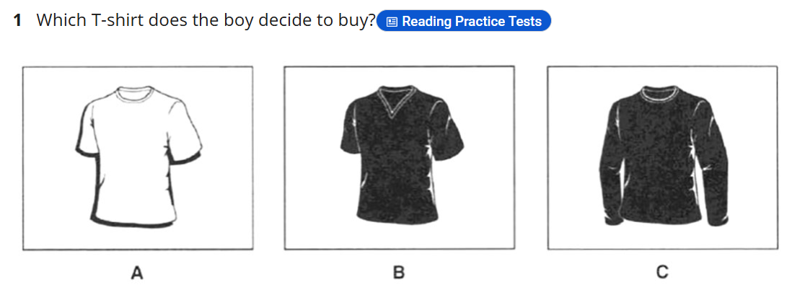
Retrieval Practice
WALT: Understand, with support most of the main points of short and extended texts.
https://englishpracticetest.net/practice-listening-test-for-b1-with-answer-and-audioscript-test-03/

Slide 4
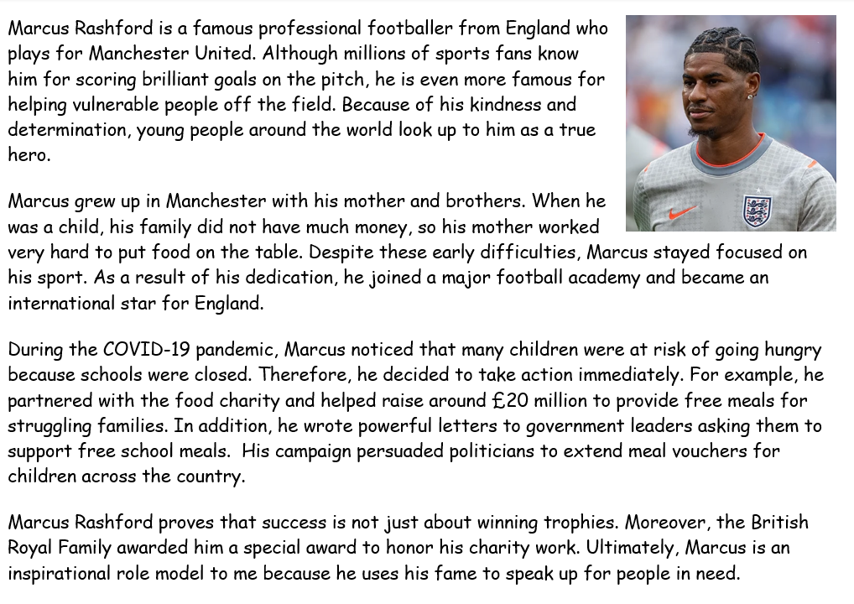
Read the text independently.
WALT: Understand, with support most of the main points of short and extended texts.

Slide 5
I do Why is Marcus Rashford famous?
WALT: Understand, with support most of the main points of short and extended texts.

Slide 6
We do What word describes Marcus Rashford’s work ethic?
WALT: Understand, with support most of the main points of short and extended texts.

Slide 7
You do When did Marcus Rashford decide to help children?
WALT: Understand, with support most of the main points of short and extended texts.

Slide 8
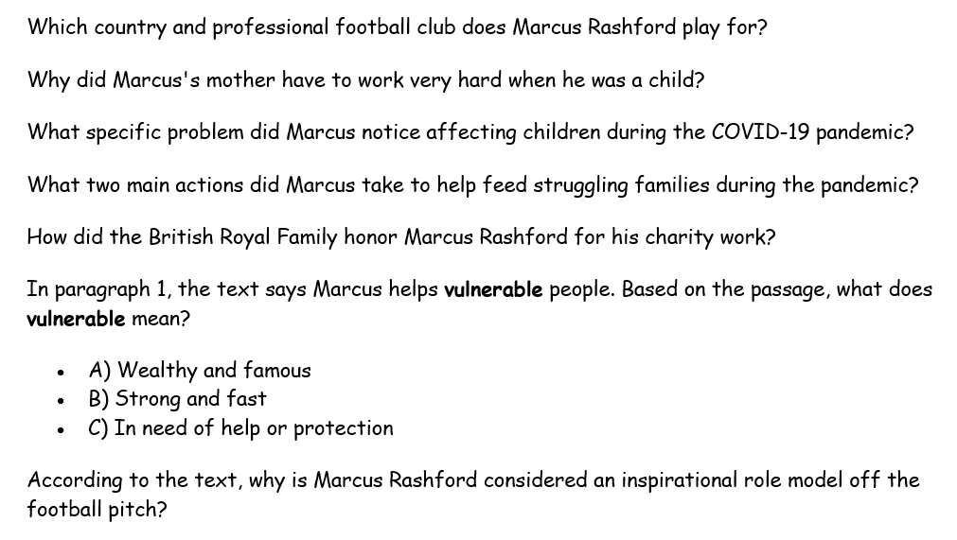
Your task
WALT: Understand, with support most of the main points of short and extended texts.

Slide 9
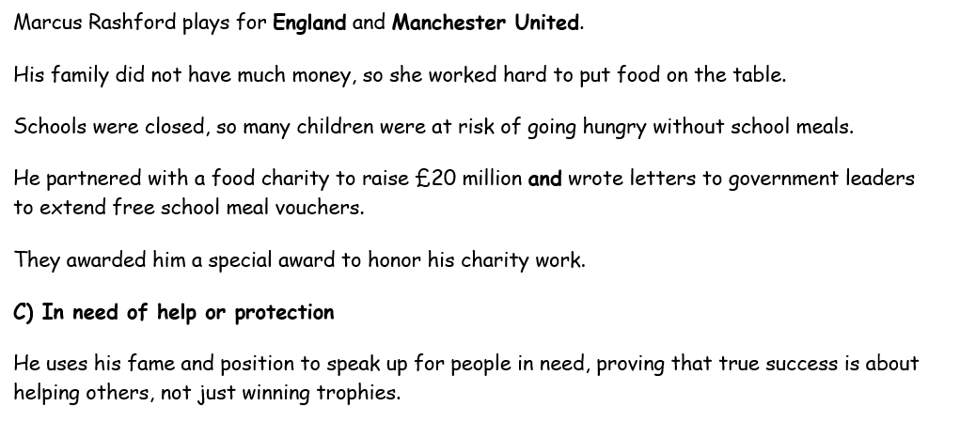
Answers
WALT: Understand, with support most of the main points of short and extended texts.

Slide 10
WALT: Understand, with support most of the main points of short and extended texts.
With support, I can answer comprehension questions on a text.
Independently, I can answer comprehension questions on a text.

